Slide 1

Theatre Arts with
Ms. Stuart

Slide 2
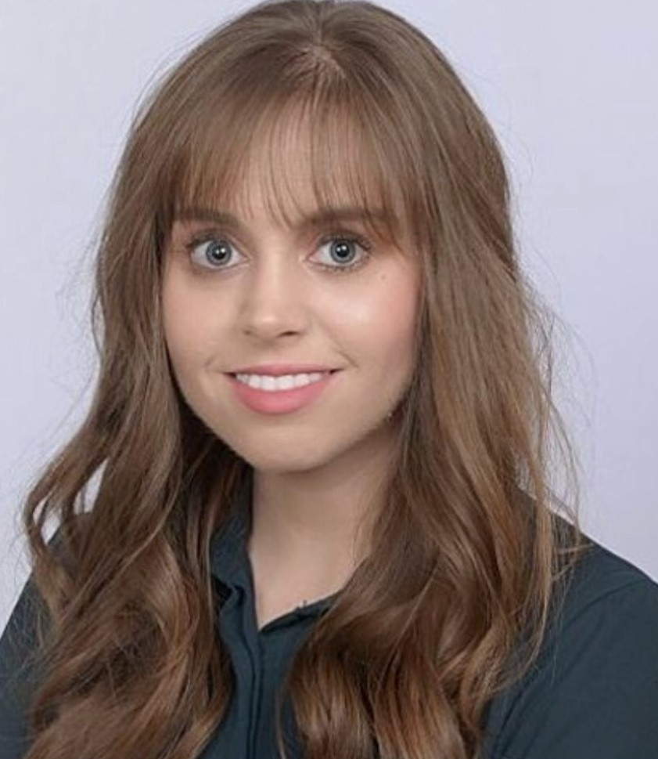
Caitlin Stuart, theatre arts
Beginner Theatre
This introductory theatre course will focus on creative expression through theatrical performance. Students will become skilled at employing: acting techniques, movement & body control, proper vocalization methods, and the development of characters from different periods and styles of drama. Students will explore historical and cultural studies in theatre and have opportunities to see live professional theater.
Intermediate Theatre
This intermediate theatre course is an extension and further exploration of the concepts and training covered in Beginner Theatre. Students of Intermediate Theatre will refine skills in theatrical creative expression. Levels of expectations and approaches will vary depending on the assignment.
Advance Theatre
Students audition for teacher approval into this course. This class will explore play production more in depth through application and public performance. The students will develop skills to deliver proficient monologues and discover empathy to create in-depth characterization

Slide 3


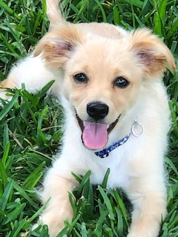
About me! Ms. Stuart
I have the cutest dog named Oakley, who is currently a year and a half.
Experience in Film and Tv as well as Theatre experience as early as 3rd grade.
My hobbies include traveling, singing, dancing, and playing with Oakley.

Slide 4
Ms. Stuart, theatre arts
Classroom Materials
Students will need Chromebook for Do Now’s on Canvas, Notebook, and Pen
Schedule for Class
Each students will arrive to class and complete Do Now on Canvas, The Warm-Up Leader will lead warm-ups for the day. After completing warm-up, the students will begin lesson for the day and will have team building activity.
Grading Scale
You will have at least two grades per week. On the Canvas you will have assignments that vary from discussions, flip grids, group projects, quizzes, and tests.
30%- Exams/ Evaluations/ Performance/ Rubrics
70%-Daily Grades/Quizzes/ Homework/ Participation

Slide 5
Theatre Arts projects and productions
Beginner and Intermediate Theatre: Group and Individual project through out the year. Project Examples include (Urban Legend, Lip Sync Battle, Musical Theatre, Tech Crew Project, Spring Production for Parents.)
Advance Theatre: Three Productions this year. We will have our UIL Fall Production (Small Actors), Winter Production (Wolves) in January, and Spring Production in May (The Outsiders).

Slide 6
Classroom Rules!
1) Be KIND to One Another
2) Respect Student Performances and Audience Etiquette
3)Complete Homework on the Canvas or complete assignments in the classroom.
4) Please Come to Class Prepared with Classroom Materials.
5) Let Loose and Have Fun!

Slide 7
Debate information
Debate is a Club for 7th and 8th grade only
Students will develop public speaking and research skills.
We have tryouts that begin the second week of school. The students will write a case based on a topic provided and will present that case to small group leaders. A board students and faculty based on the case and presentation will decide who will join the team.
The student must also provide two recommendation letters as well.
The debate club has meetings on Tuesday and Thursday during the homeroom period.
Students will have tournaments on Saturdays that range from 8:00 am – 5:30 pm

Slide 8

Ms. Stuart, THEATRE Arts
Contact information: Ms. Stuart
Email: caitlin.stuart@houstonisd.org
Conference Period: A1: 7:45-9:20
Homeroom: 1:00- 1:45
Advance Theatre (MWF)
Debate (T&TH)

